Slide 1

Natural Language Processing (NLP) with LUIS
Presentation to ML Workshop
September 2018

Slide 2

LUIS
Language Understanding Intelligent Service
NLP Cognitive Service
Understand Intent
Understand Entities

Slide 3
Bots + LUIS
Intent
Entity
I would like the latest stock value of Microsoft.
Utterance

Slide 4
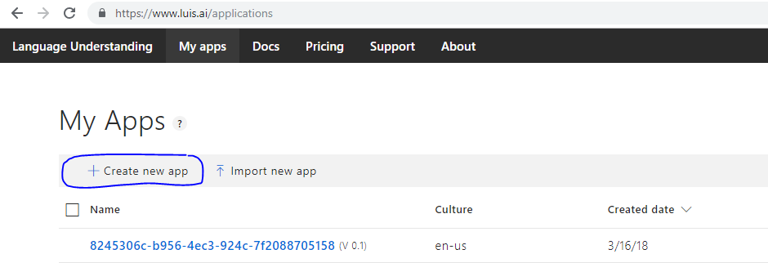
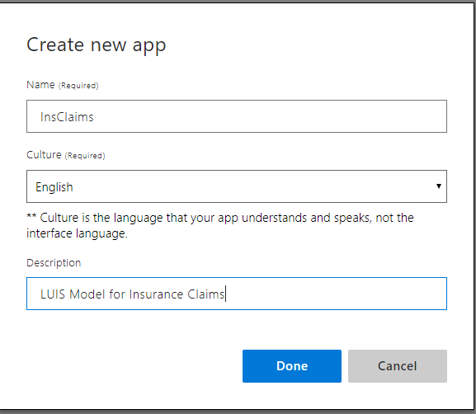
LUIS: Create a LUIS App

Slide 5
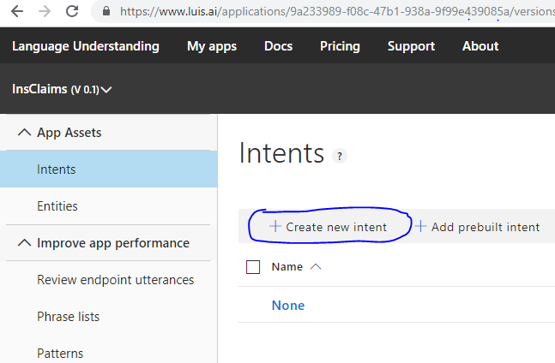
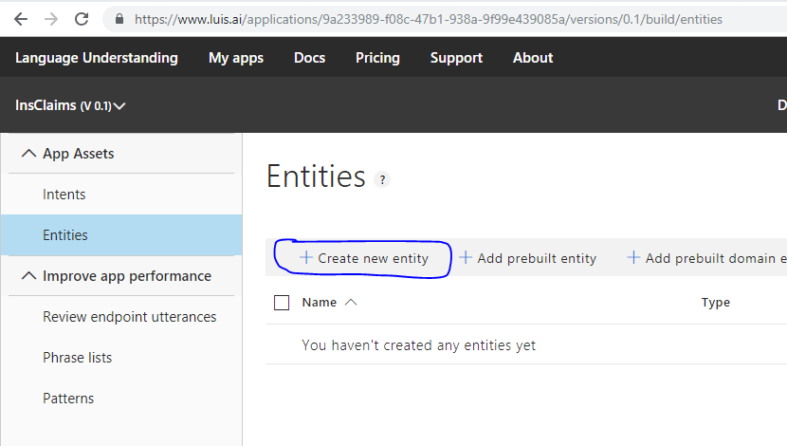
LUIS: Add Intents & Entities

Slide 6
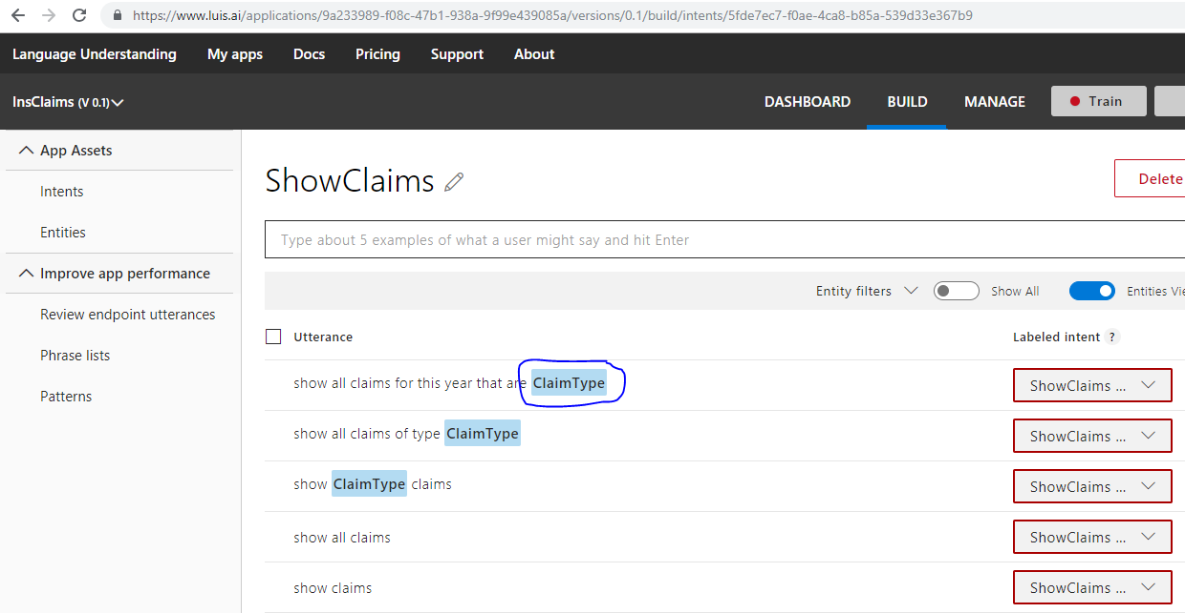
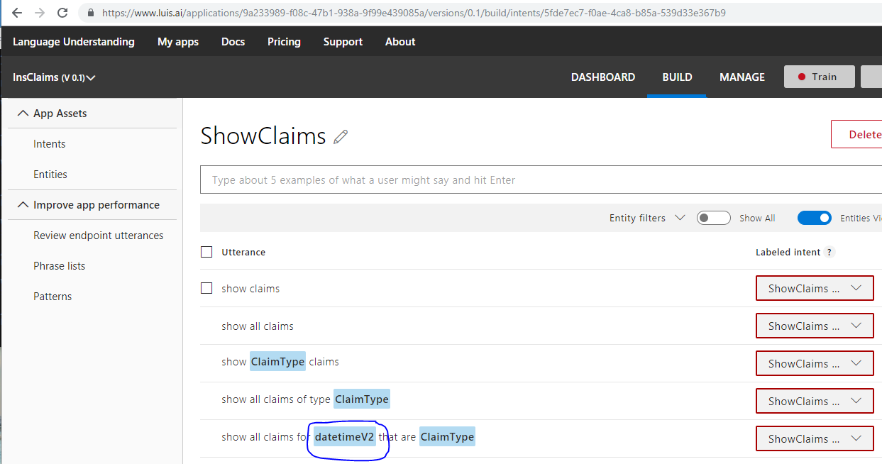
LUIS: Add utterances for intents
Minimum of 5 utterances are required per intent for model training
Known Entity
New Entities are identified as they are added in the intent utterances

Slide 7
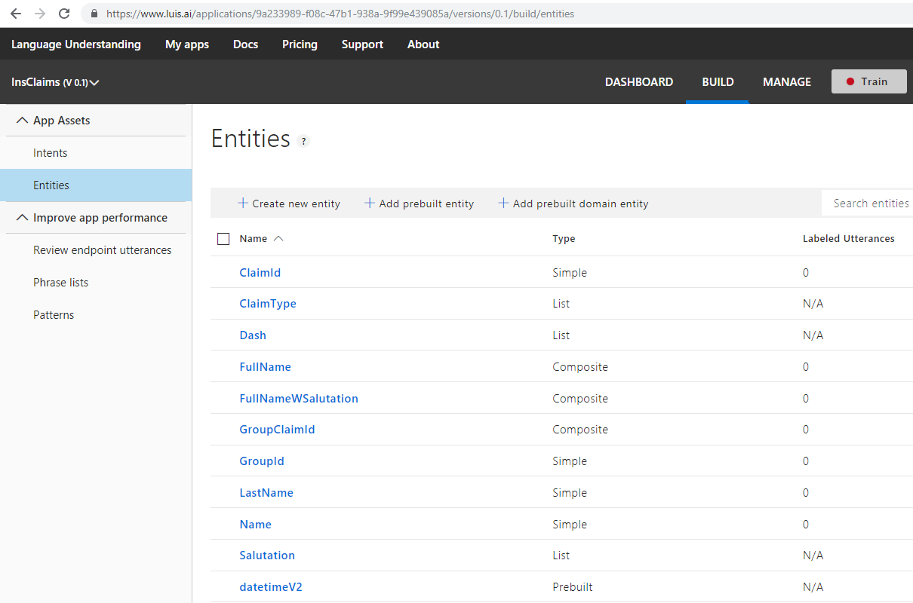
LUIS: Entities

Slide 8
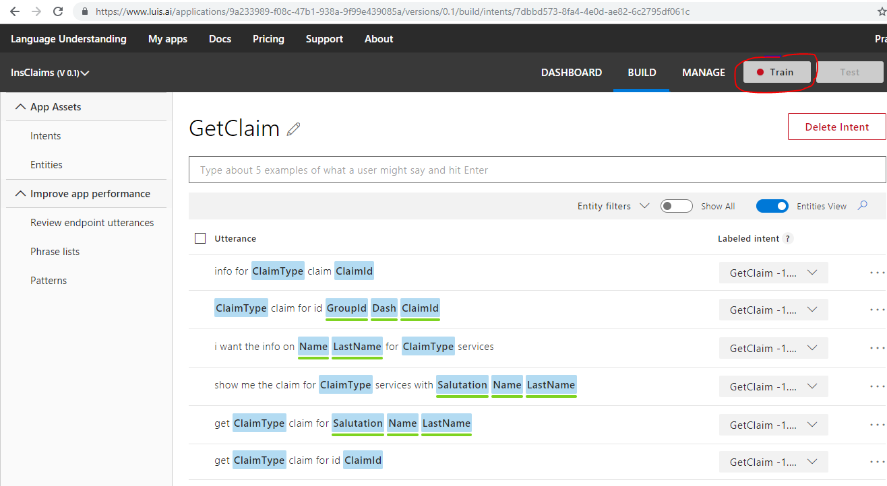
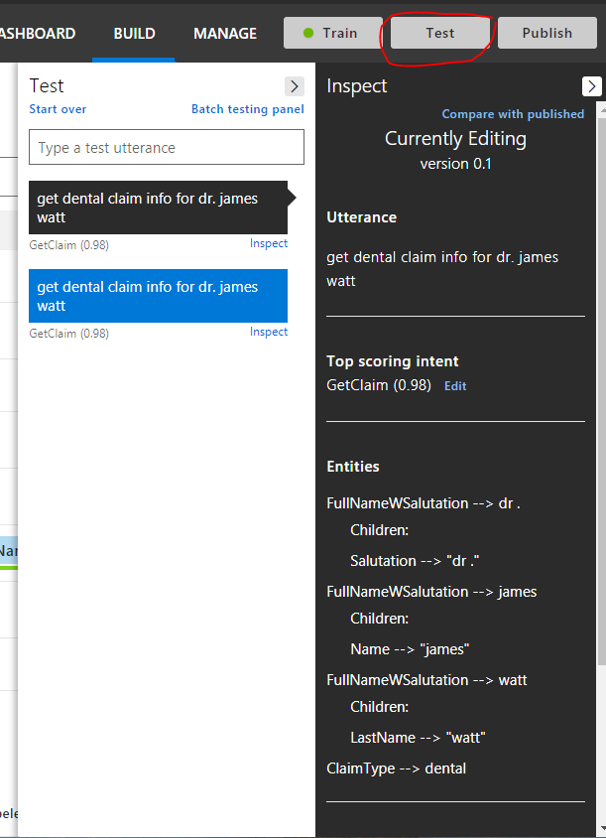
LUIS: Train the Model and Test

Slide 9
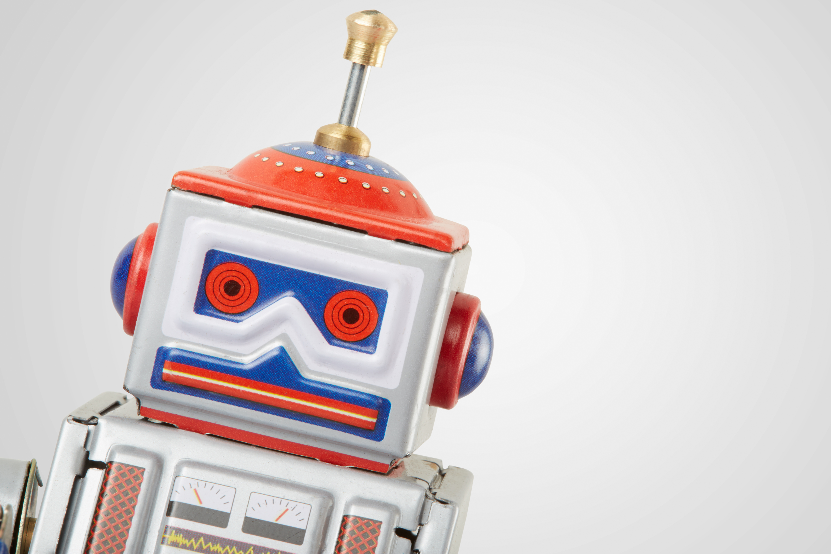
What is a Bot?
An application that performs one or more automated tasks.
Chatbots:
use conversation as the interface
Notes:
A bot is software that is designed to automate the kinds of tasks you would usually do on your own,
They sit in front of processes/tasks – reservations, scheduling dinner, FAQ, pro-active info, an assistant for a particular task.
The increasingly common form of bots, chatbots, simulate conversation.
Solve a problem,
Run anywhere on any device

Slide 10
Bot patterns
01
Information Retrieval
Lookup, reference and information seeking, scenarios backed by a data source
“What are the features of service plan A?”
“When are the trains leaving on Thursday?”
02
Transactional
Look up info, make amendments, scenarios backed by
a data source
“Upgrade my account to plan B”
“book two tickets for film A on Monday using my credit card”
03
Advisory Role
Prescriptive guidance via ‘expert systems’ based on user input.
“How much can I save if I switch to payment plan B?”
“Should I add an additional component to my service plan? ”
04
Social Conversations
Ability to sense sentiment and engage in open-ended conversation within the bots area of expertise.
“Your product is terrible, I would like a refund.”
“I have had a terrible experience, who can I talk to?”
Notes:
Bot help people find information faster in my current context – in flow of conversation
Bots tend to be fairly transactional – bot framework can keep state/context and could for example initiate a message two weeks later in the canvas
Advisory – experts in certain domains, linking user to the domain knowledge
Conversational – detect sentiment, react differently based on this, ability to hand off to human?

Slide 11
Microsoft Bot Framework

Slide 12
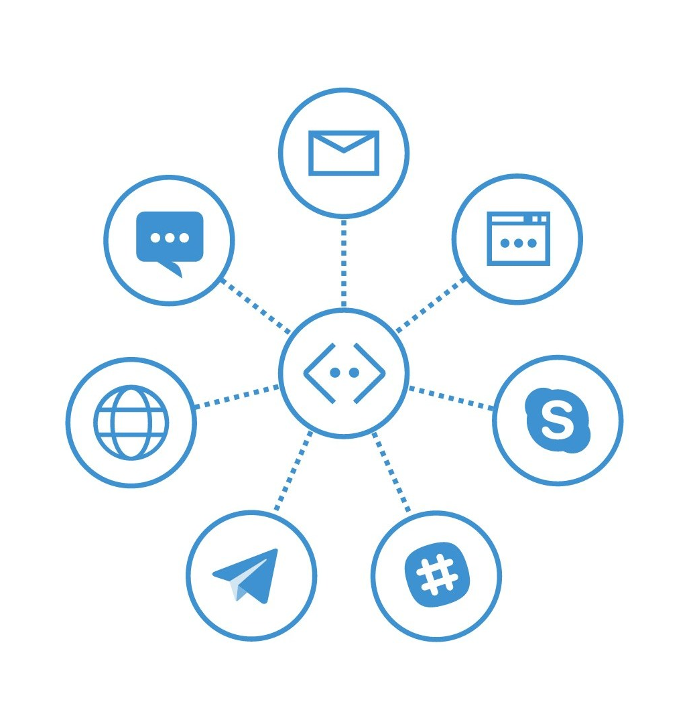
Why Bot Framework?
Build one bot
Host one bot
Maintain one bot

Slide 13
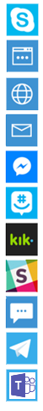
Bot Connector
Bot Channels
Skype
Bot Connector
Web chat
Direct Line
Routes Messages
Manages State
Bot registration/directory
Session Tracking
Per-user, per-bot storage
APIs
Bot
Email O365
Facebook Messenger
Web Application
GroupMe
Kik
Slack
SMS
Telegram
Microsoft Teams

Slide 14
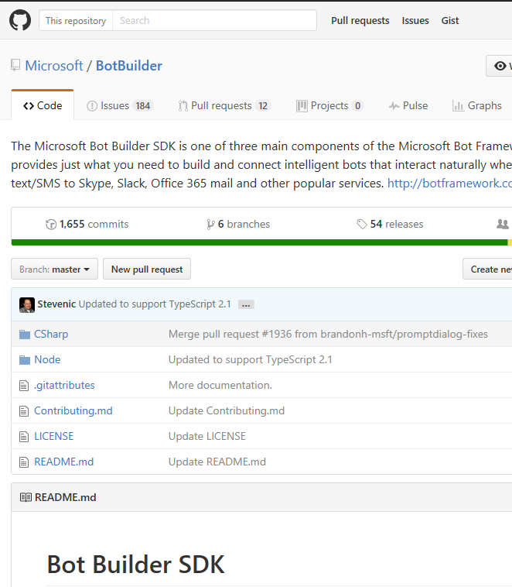
Bot Builder SDK
C#
NodeJS
Cross platform emulator

Slide 15
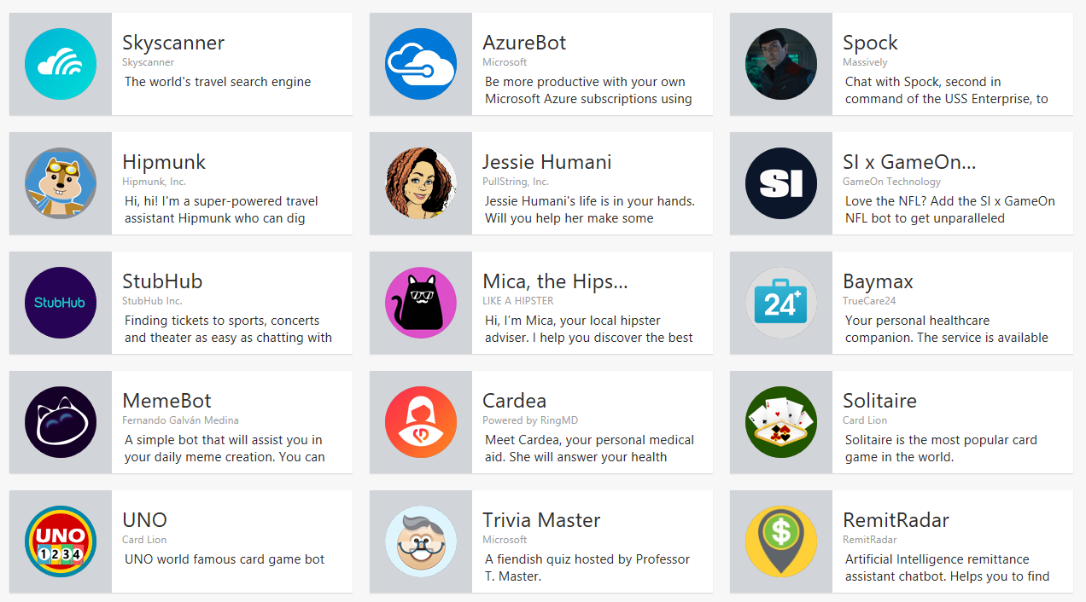
Bot Directory

Slide 16
Building BOts

Slide 17
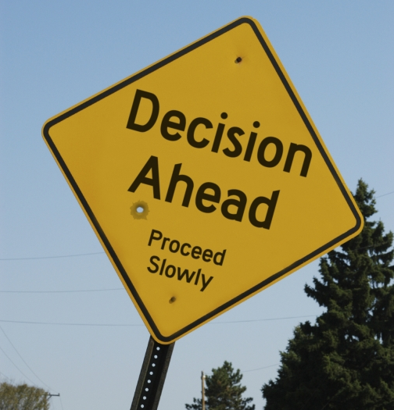
To Bot or Not?
Choose a small, discreet scenario
Why is it better as a bot?
Start small, fail fast
Notes:
Choose something small and discreet. For example, a bank may just do a ‘get your balance’ bot. A food tracker may just do an ‘enter food’ bot
Why is the thing you want to do betters as a bot compared to an app or website?
Don’t try to replicate your whole app in a bot

Slide 18
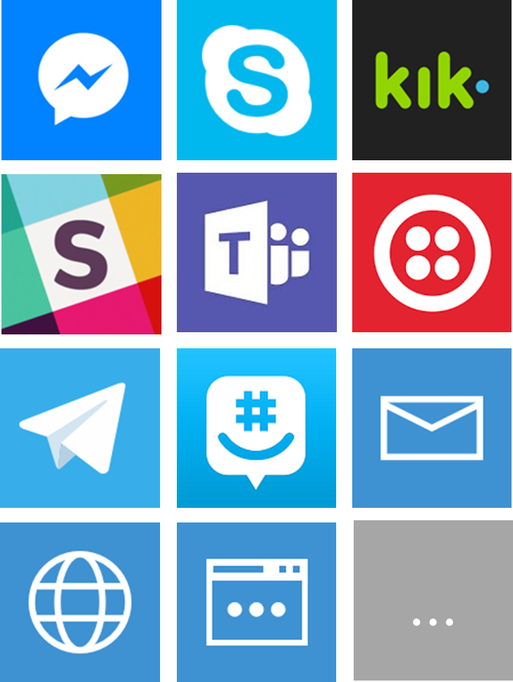
Choose your channels
Everything? Even SMS?
API (Direct Line)
Trade-off: Nice UI vs Reach
Notes:
Facebook
Skype
Kik
Slack
Microsoft Teams (office 365 based chat feature)
Twillio (SMS)
Telegram
GroupMe
Email
Web Chat Control (iFrame)
API
More coming ….

Slide 19


Programming Language

Slide 20

Bots != NLP
You don’t always have to use NLP
Users still prefer buttons & UI
Consider your channels (i.e. SMS)

Slide 21
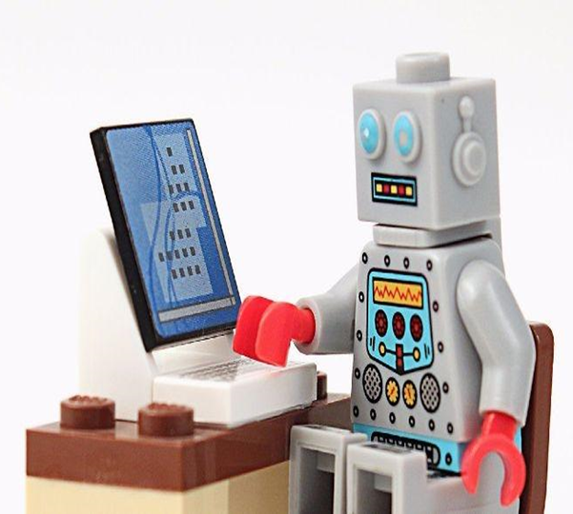
BOT
INTELLIGENCE
MAKING BOTS
SMARTER
Notes:
Make it great –
by making it useful,
performing useful tasks,
by reducing user friction
By making bot available where the user are.
Add smart functionality that augments its capabilities.

Slide 22


BOTS + COGNITIVE:
QnA MAKER
Cognitive Services API
Build, train and publish
questionand answer bot
based on existing FAQs
https://www.qnamaker.ai
Notes:
Recently added to the cognitive services
Still in preview
QnA Maker is a free, easy-to-use, REST API- and web-based service that trains AI to respond to users’ questions in a more natural, conversational way.
QnA Maker Service distills semi-structured data like those commonly found in website FAQs into distinct, helpful answers.
Build, train and publish a simple question and answer bot based on FAQ URLs, structured documents or editorial content in minutes.
Creating your knowledge base is as simple as pointing the tool to the existing content, and ingesting the QnA content.
Currently the tool can auto-extract question and answer pairs from most FAQ URLs and documents
Update QnA
Train and publish - > REST endpoint
Takes in a question and responds with a best matched answer and a confidence score

Slide 23
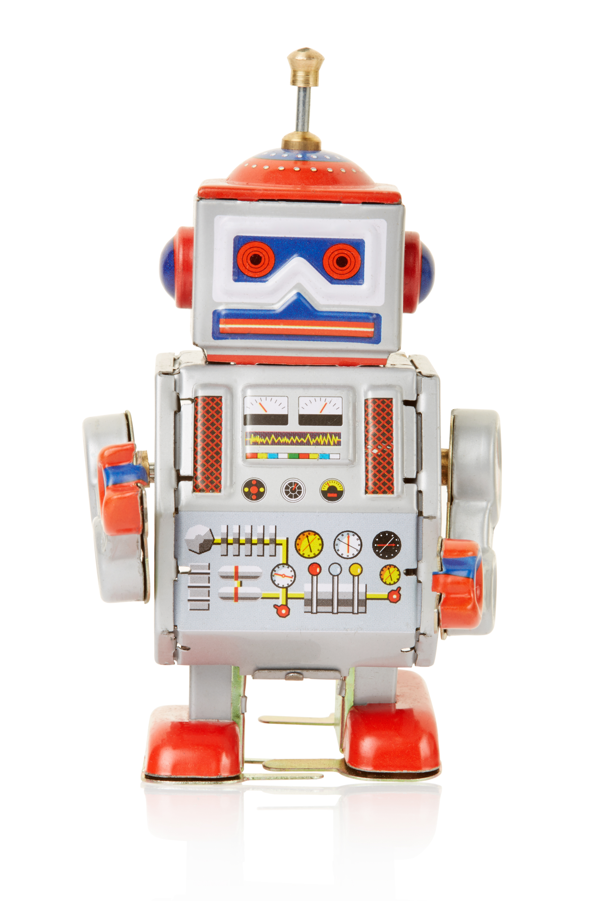
Bots + Cognitive Services
Computer vision API human readable captions
Computer vision API OCR for capturing information (receipts)
Face API facial verification/authentication
Speech API voice verification/authentication
LUIS API understanding intent
Knowledge APIs retail product recommendation
Autosuggest API ease query input
Linguistic API sentiment analysis
QnA Maker conversational Interface for FAQs
Translation API Auto text translation & language detection
Translation API Auto speech (voice) translation
Bing Maps API User location
Notes:
More serious use cases for bots and cognitives:
Apps Powered Computer vision API- to create captions for the content of an image that has been uploaded to a bot
Like CaptionBot.ai
2. A bot to authenticate users using a voiceprint by leveraging the Speech APIs
Authentication as a user speaks to the bot with a speaker verification profile or “voiceprint”
Using the LUIS (Language Understanding Intelligent Service) API, a bot can recognize the intent of a user
LUIS analysis for queries such as “What is the weather in Toyko today?” using entities to parse out intent (what the user is asking for)
4. Knowledge APIs can give a bot the ability to recommend products frequently bought together based on our knowledge and/or a user’s history
Also, Knowledge could search through a graph database to return relevant academic papers from a natural language query
5. The Autosuggest API from Search can ease the burden of typing queries to a web search bot
Search also has other capabilities such as returning the latest trending news on a topic for example
by MS Cognitive Services

Slide 24
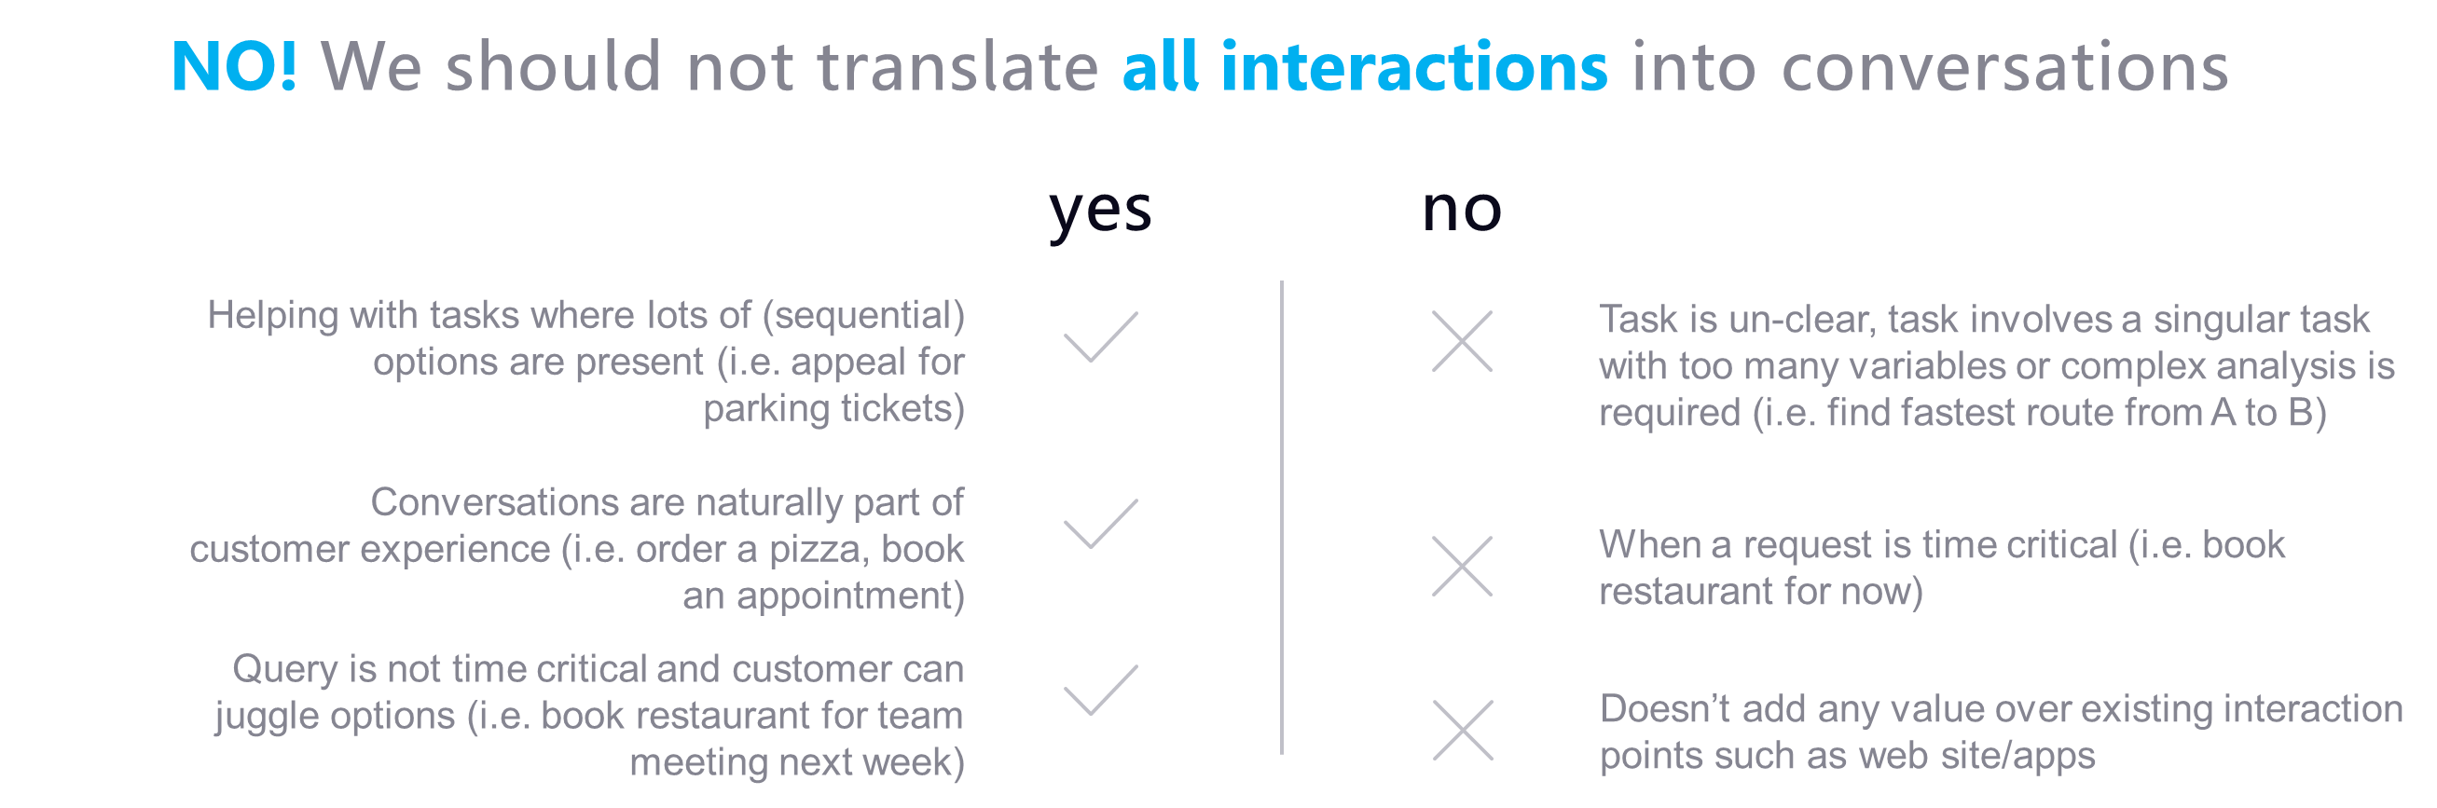
Bots for everything?
Notes:
Use bots for well defined, simple tasks.
Bots do not need to have NLP – they can utilize keywords, provide a guided experience.
If using NLP then don’t have a complex bot as you will not be able to handle all user input and frustration and user retention issues creep in.
Above all – does using a bot make sense for that scenario – this can be internal process, B2B as well as B2C

Slide 25
BOTS bridge the gap between apps and humans

